Slide 1
Front End Engineering-I Project
Team Details:
1.VANSHITA [2310992318] {Project leader}
2.VARUN SAINI [2310992319]
3. VEER VANSHAJ WADHERA [2310992320]
Faculty Coordinator: Preeti Saini
:
Chitkara University Institute of Engineering and Technology,
Chitkara University, Punjab

Slide 2
Table of Contents
Introduction
Problem Statement
Technical Details
Key Features
Project Highlights
Conclusion
Links used

Slide 3
Introduction
TITLE: IMAGE GALLERY WITH FILTERS
Team Details:
1.VANSHITA [2310992318] [Team Leader]
2.VARUN SAINI [2310992319]
3. VEER VANSHAJ WADHERA [2310992320]
Filterable Image Gallery is a popular web element that is used around various websites.
It is a kind of image gallery where a large number of images are neatly arranged together. The notable point is that all the images can be sorted by category here.
There is a navigation bar where all the categories are sorted. When clicking on any one of those categories. Then all the images in that category are seen and the rest of the images are hidden. As a result, the user can easily find the images of his choice. This type of design is mainly used in many websites where a lot of images are put together.
However, in this case We have created this Filterable Image Gallery using HTML and CSS.

Slide 4
Problem Statement
IMAGE GALLERY WITH FILTERS
The problem that the project aims to solve is the efficient organization and retrieval of images. Without filters , users may struggle to quickly find specific images in large collection. Filters provide a solution by allowing users to narrow down their image searches based on criteria such as tags , content or other data , making it easier to locate and view the desired images.
SOME RELEVANT BACKGROUND INFORMATION AND RESEARCH
USER NEEDS : What type of images the user want? What filtering options are most important to them
EXISITING SOLUTIONS: Researched existing image gallery websites
to analyse their features , strengths , weaknesses for improvement in our project.
FILTERING ALGORITHMS: Exploring different filtering algorithms such as coloured-based filters ,
Content analysis , to determine which are more suitable for our project.
USER INTERFACE DESIGN: For considering usability and accessibility to create a user friendly gallery with filter options.

Slide 5
Technical Details
BRIEF OVERVIEW OF THE TECHNOLOGIES AND METHODS USED ARE:
1.HTML - 5 { HYPERTEXT MARKUP LANGUAGE}:
Use to structure the web page , including elements for headers , image containers and filters.
2. CSS{CASCADING STYLE SHEETS}:
For styling and formatting the web page , making it appealing and user friendly.
3.IMAGE CONTAINERS:
Creating HTML elements (e.g. <div>)to serve as image containers where we display images.
4.GRID LAYOUT:
Utilizing flexbox for arranging your image containers in a desired layout.
5.STYLING:
Applying CSS styles to control the appearance of gallery elements such as borders , margins , padding and fonts.

Slide 6
Key Features
FUNCTIONALITY:
Our project works to ease the usage of a complicated gallery in such a way that which ever type of pictures you want to browse you just need a single click on the name tag of that type such as CATS,WALLPAPERS,CARS etc.
DESIGN/STYLING:
With the help of CSS we have tried making an user-friendly and an attractive filterable image gallery. Which is an eye-catching and playful project with different styles.
CODE REVIEW:
With the help of HTML and INLINE CSS we have completed this project using many different tags such as <header> , <h1> , <img> , <div> etc.
And have completed the styling with the help of inline CSS by using <style> tag , background-color , font-family , font-size etc inside the <style> tag.

Slide 7
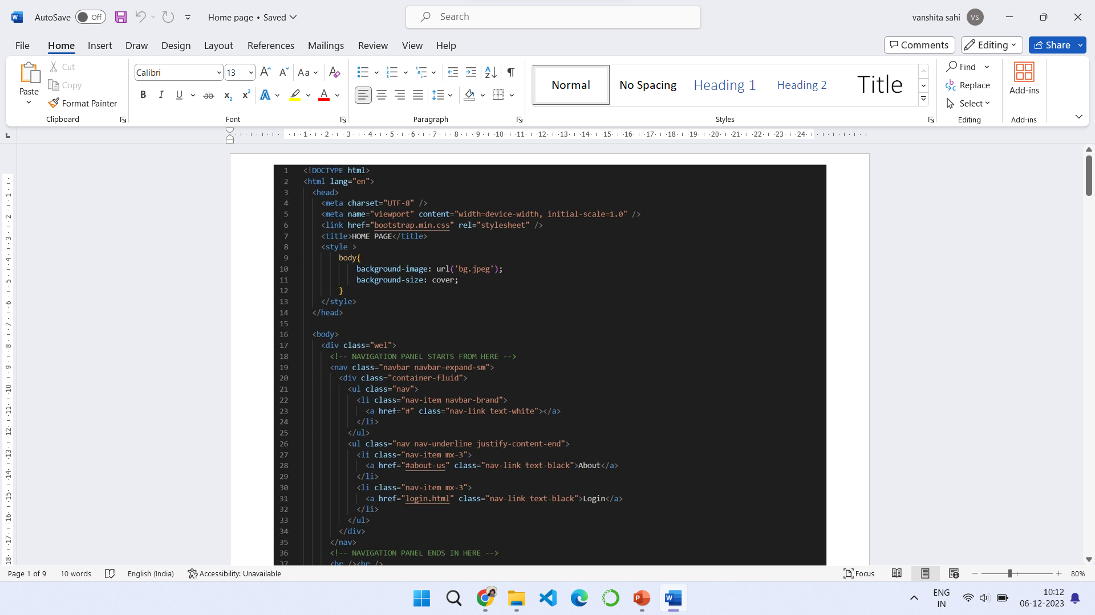

Slide 8
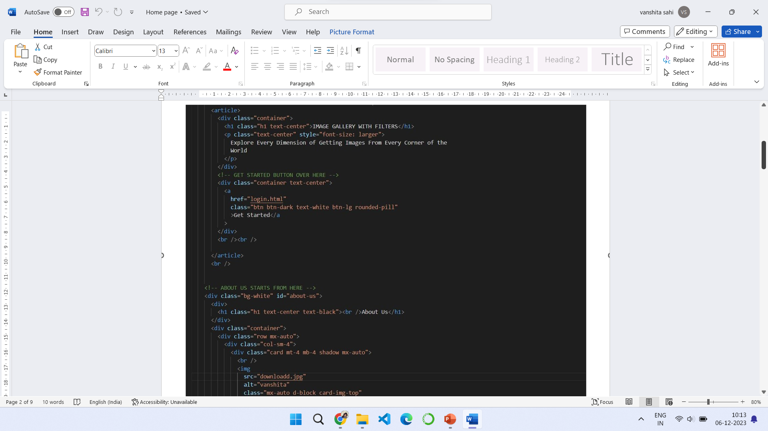

Slide 9
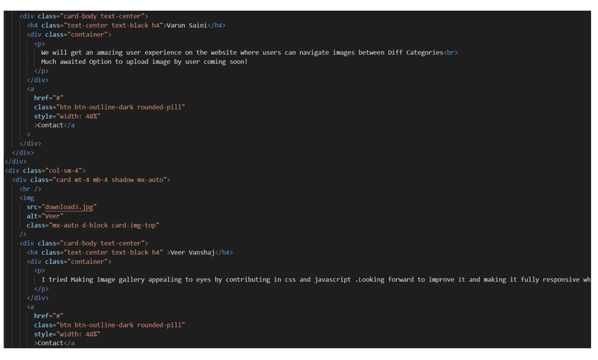

Slide 10
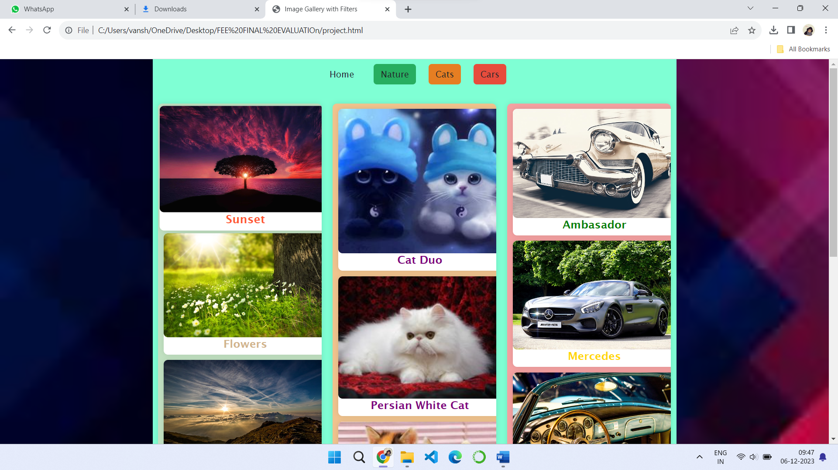
Project Highlights

Slide 11
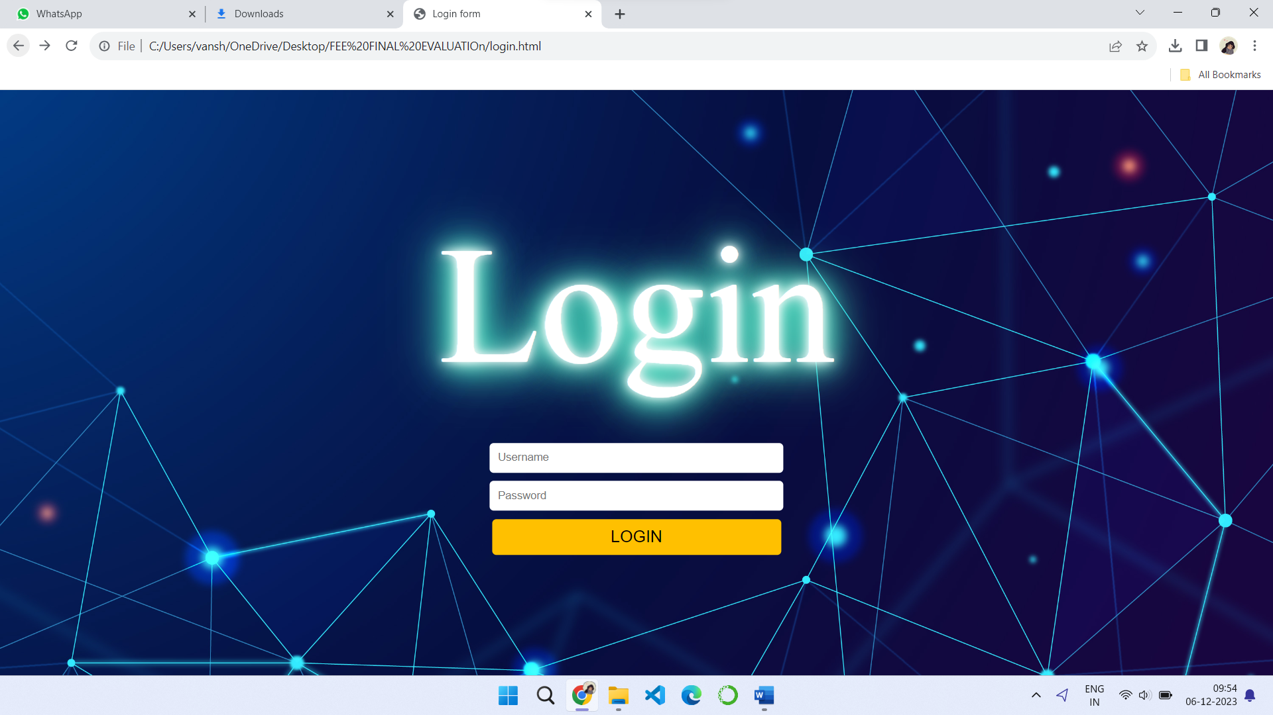
Project Highlights }

Slide 12
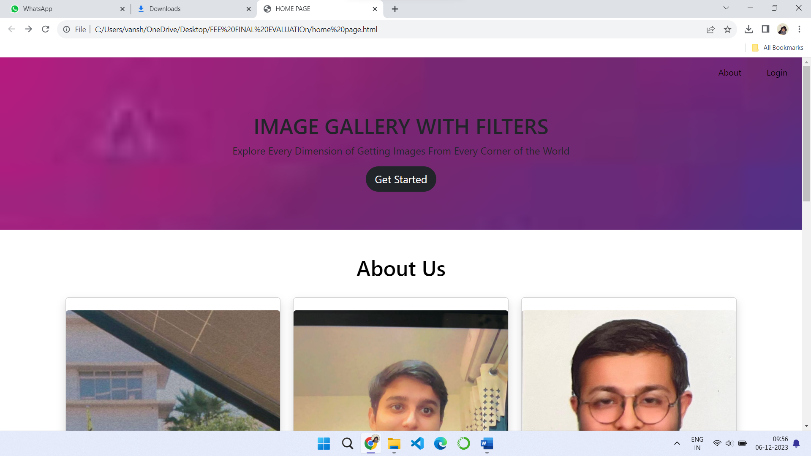
Project Highlights

Slide 13
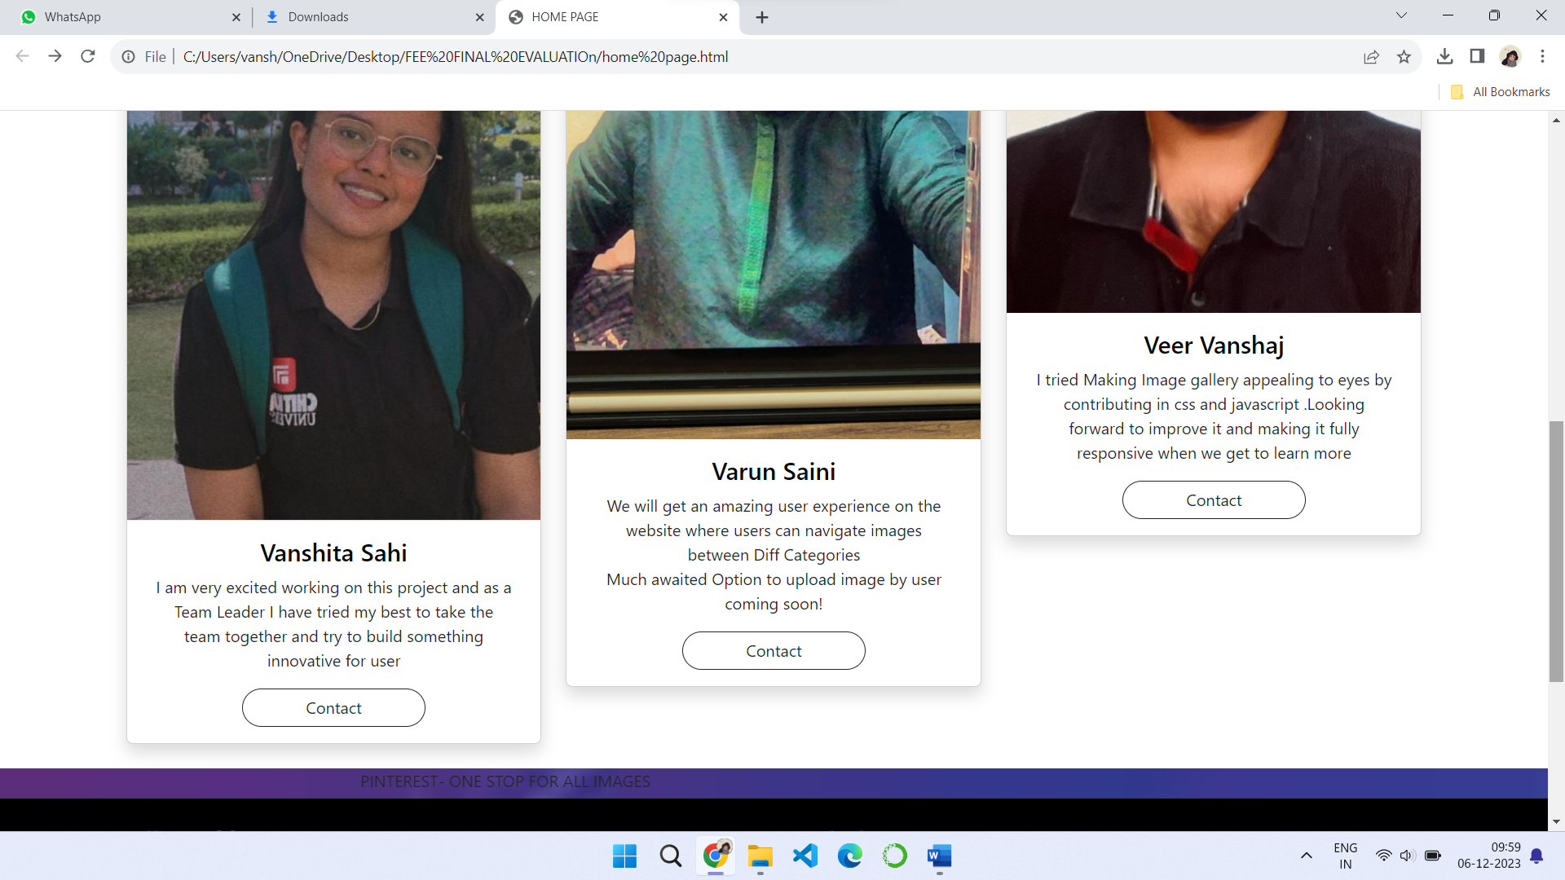
Project Highlights

Slide 14
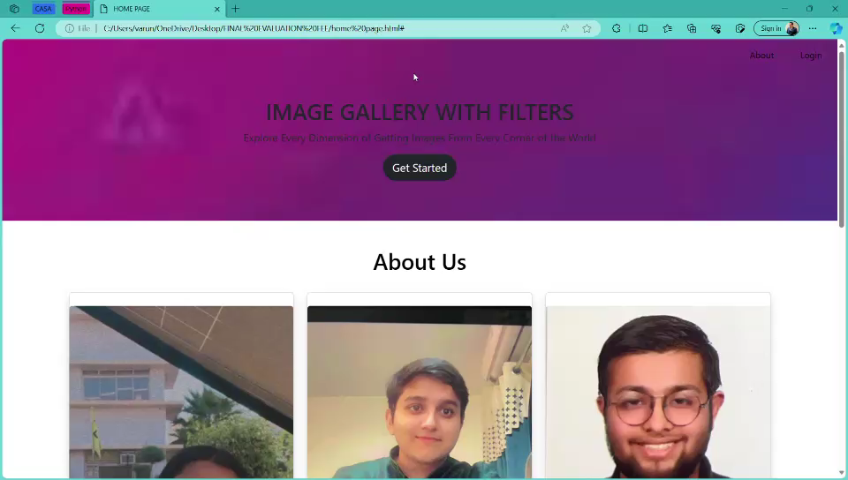
Project Highlights Project [OUTPUT]

Slide 15
Conclusion
CONCLUSION:
A user-friendly and an attractive gallery is formed by 3 of us to help and make it an easy way for people to go through an image gallery with n number of photos by just clicking on the type of picture you want to see and getting that instantly rather than scrolling through the whole page for finding that.

Slide 16
References/Links used
https://www.w3schools.com/howto/howto_js_portfolio_filter.asp
https://youtu.be/sHG3Sf6XN9g?si=cnYV9cju3XX9SvmX
https://www.youtube.com/watch?v=ZjrqnxDEkzA&t=103s

Slide 17


